Slide 2
Cristian amador
Class of 2017

Slide 3
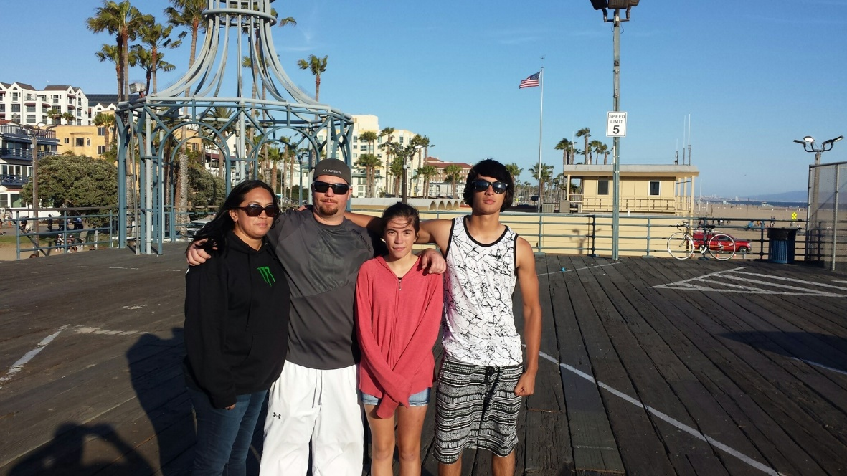
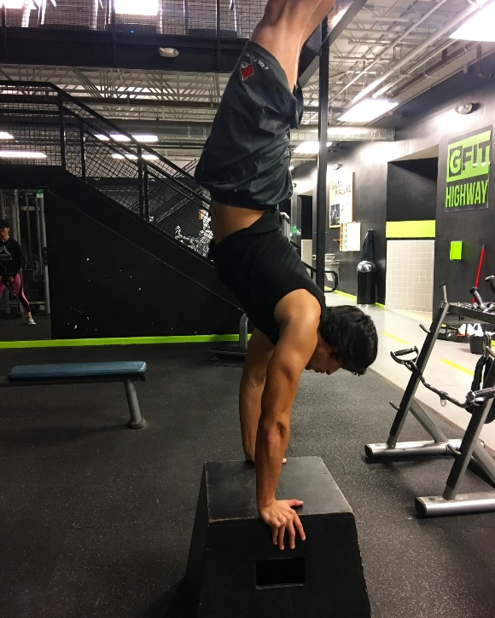
About me
Come from a family of 4
Moved a lot when little
Athletic person
Dedication

Slide 4
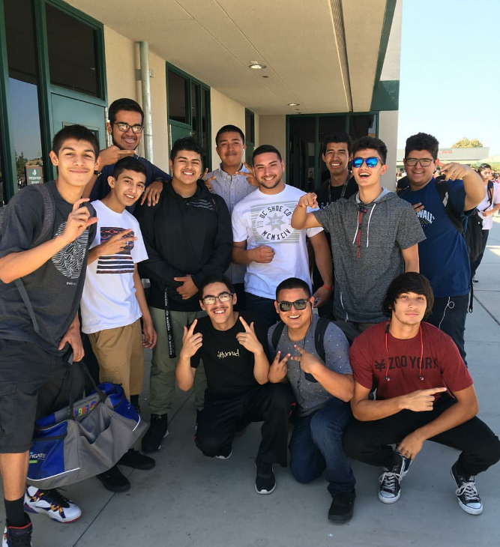
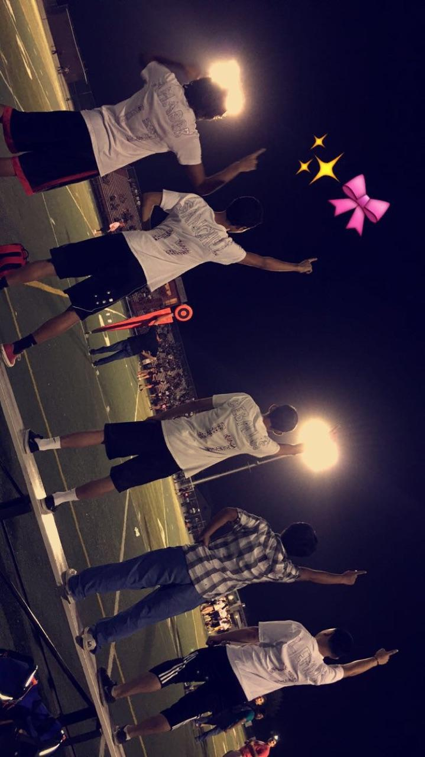
High school experiences
Football
Basketball
Golf
Being accountable for actions in pbs
Challenges
Tendency to forget deadlines

Slide 5
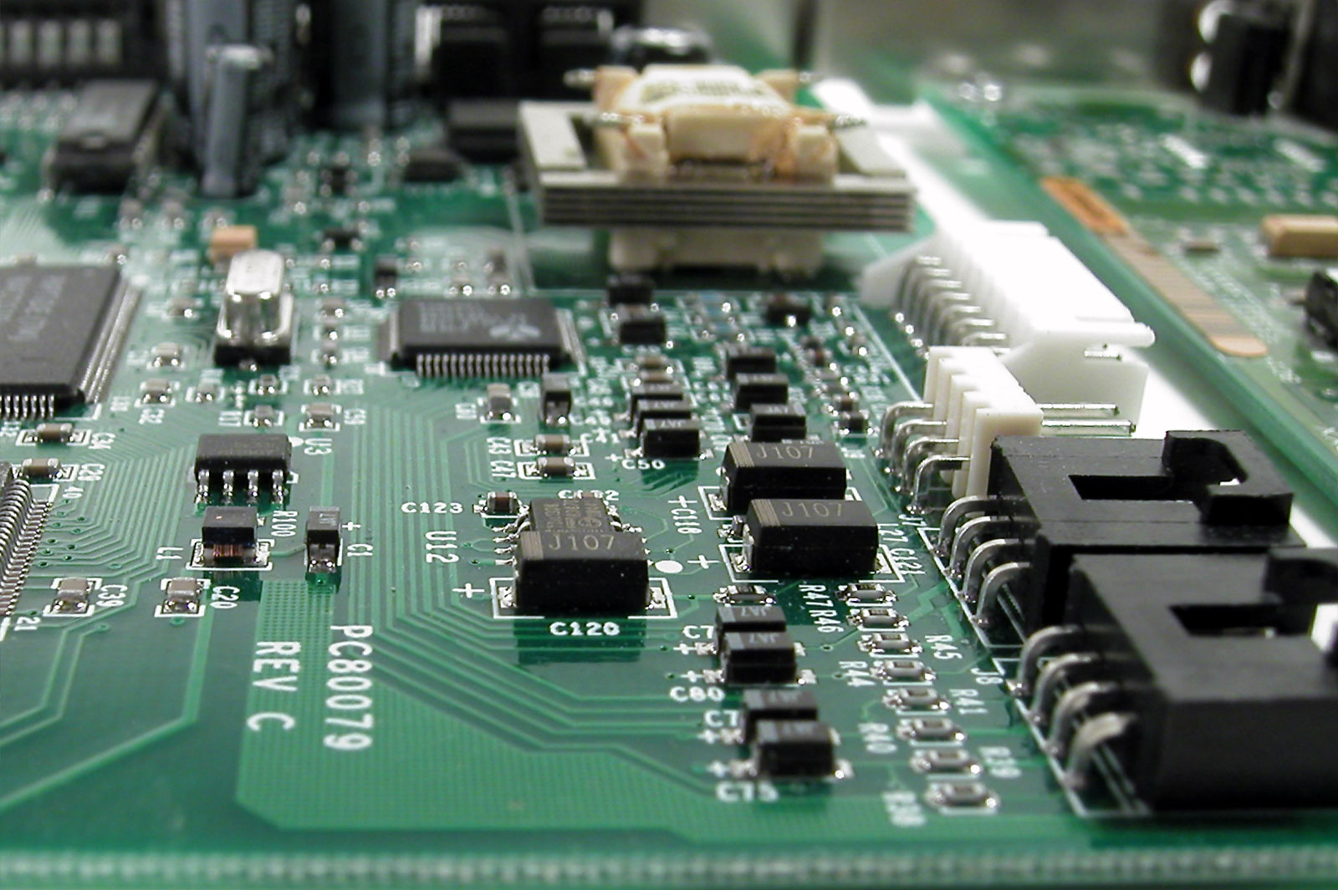
Job shadow
Job shadowed computer engineer
Kawneer, Visalia
Vital to the company
Somewhat relates to my pathway

Slide 6
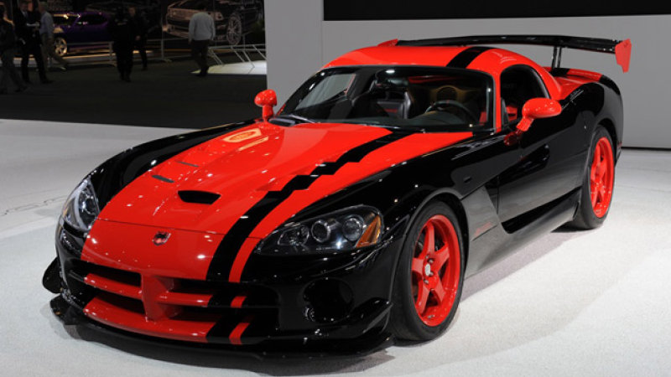
pathway
Automotive technology
Was Pursuing a career in automotive engineering
Automobiles are very intricate and complex

Slide 7
Post-high school plans
Planning on attending CSU Northridge
Was Majoring in mechanical engineering
Switching majors
Family supports my decision

Slide 8
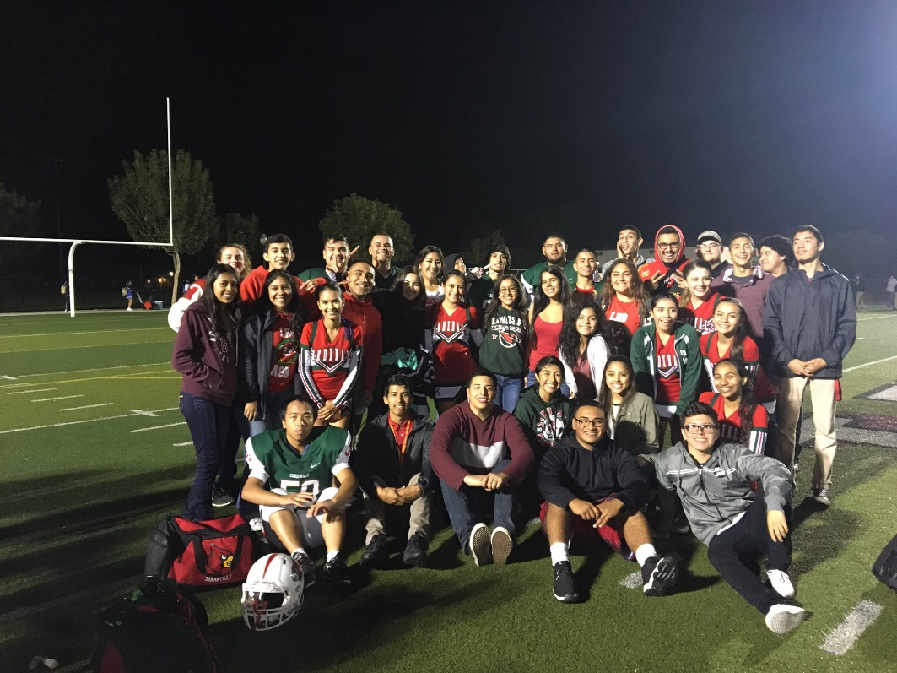
Leaving lhs
Unique experience that will always be remembered
Gave me skills that would be useful in the future
Pbs taught me to be more accountable

Slide 9
Questions?

